Slide 1

SleepWise
AI Sleep Intelligence for Students
Predicting Burnout Before It Happens.
INTELLIHACK 1.0
Team Members:-
Sourav Shankar Dhumal (RA2511026010135)
Harshit Arya (RA2511026010118)
Aditya Vijay (RA251026010114)
AI · HEALTH · ANALYTICS

Slide 2

The Real Problem
Students face a perfect storm: irregular sleep, relentless academic pressure, and screen addiction — yet no tool connects the dots.
Irregular Sleep
Over 70% of college students report insufficient sleep, with schedules shifting wildly between weekdays and weekends.
Stress + Screens
Academic stress combined with 6+ hours of daily screen time accelerates cognitive fatigue and burnout cycles.
Apps Only Track Duration
Existing sleep apps record hours slept — but never correlate with study load, mood, or stress levels.
No Burnout Prediction
Students discover burnout after it happens — not before. There is no early warning system built for academic life.

Slide 3

Why Current Solutions Fail
Traditional sleep trackers were built for general wellness — not the unique pressures of student life. Here's how they compare to SleepWise.
Traditional Sleep Trackers
SleepWise
Tracks duration only — no depth of insight
Tracks sleep quality, consistency, and patterns
No burnout prediction — reactive, not proactive
Predicts burnout before it occurs using AI trends
No academic correlation — ignores study load & stress
Correlates sleep with study hours, mood, and stress
Generic recommendations — not student-centric
Personalized, student-focused smart recommendations

Slide 4
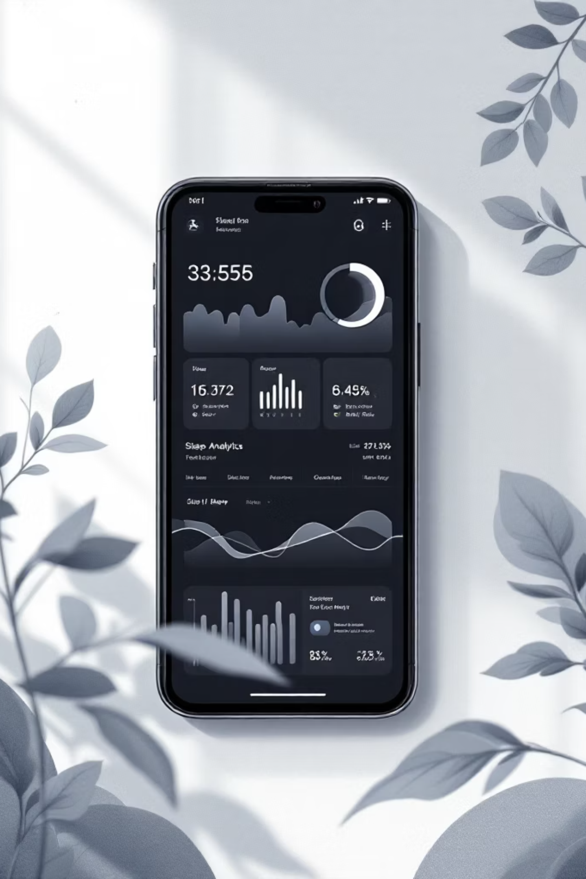



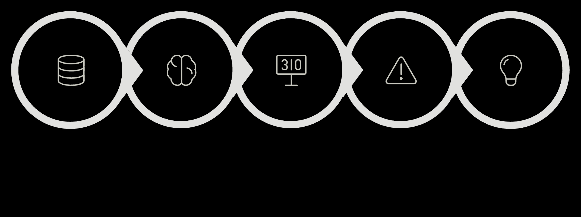





Our Solution: SleepWise
SleepWise is an AI-powered, student-focused sleep intelligence system that goes beyond tracking — it understands the full picture of student wellbeing.
Sleep Data
Duration, consistency, and cycle quality
Study Hours
Academic workload and deadline pressure
Mood
Daily emotional state and energy levels
Stress
Perceived stress and cognitive load
SleepWise correlates all four dimensions to generate a holistic Sleep Score and deliver predictive burnout alerts — before students hit the wall.
Input Data
AI Analysis
Sleep Score
Burnout Detect
Smart Tips

Slide 5

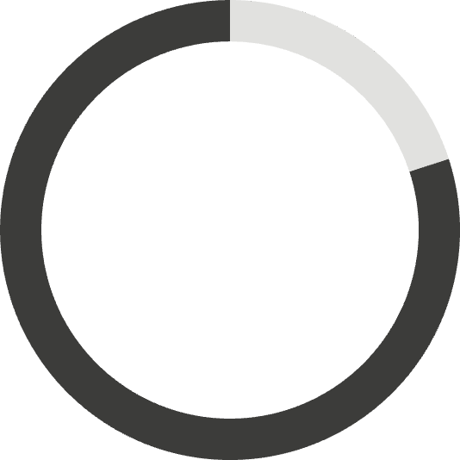
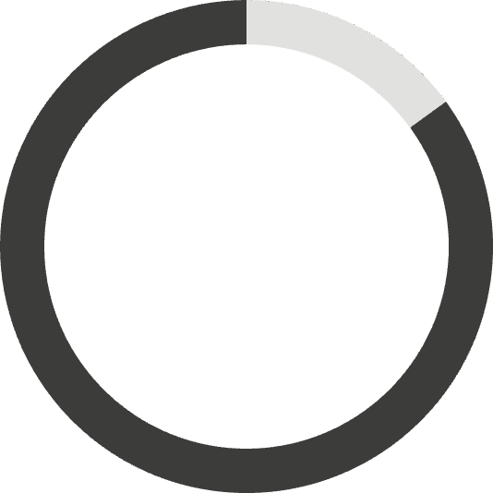
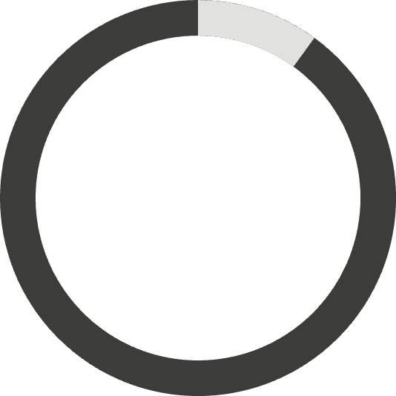
Sleep Score Intelligence
The SleepWise Sleep Score is a composite metric built from five weighted factors — giving students a single, actionable number that reflects their true recovery state.
40%
20%
15%
Sleep Duration
Consistency
Screen Time Penalty
Core hours of rest — the foundation of the score
Regularity of sleep and wake times across the week
Deduction for late-night screen exposure before bed
15%
10%
Mood Correlation
Stress Adjustment
Alignment between sleep quality and reported mood
Modifier based on academic stress and workload levels

Slide 6

Burnout Risk Detection & Predictive AI
⚠ Burnout Risk Detection
🤖 Predictive Insight Layer
SleepWise monitors three converging signals over a 7-day rolling window to flag high-risk states:
Our AI layer doesn't just react — it predicts. By analyzing multi-day trends, SleepWise identifies:
1
Deteriorating sleep patterns before they become critical
Sustained sleep deficit — consistently below optimal hours
2
Sleep debt accumulation across the academic week
High stress + low mood + high workload — the burnout triangle
3
Burnout probability — before it happens
Trend-based detection — deterioration over time, not just one bad night
4
Optimal recovery day suggestions to reset the cycle
🚨 Alert UI: "⚠ High Burnout Risk Detected — Recovery day recommended this weekend."

Slide 7
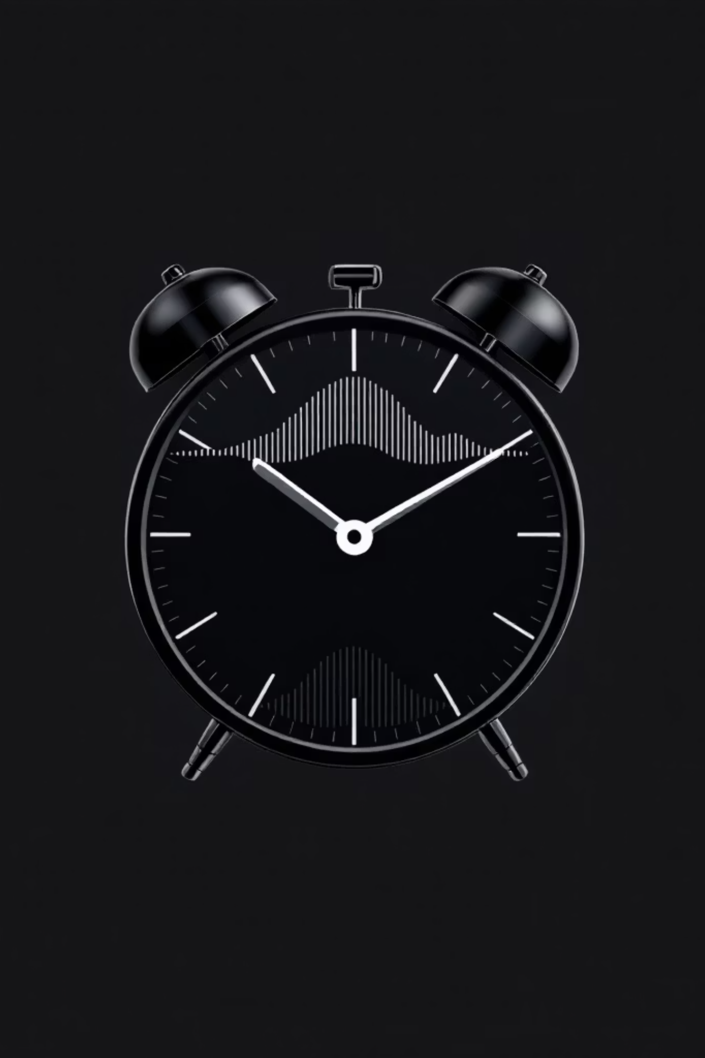
Smart Sleep Cycle Optimization
Not all sleep is equal. SleepWise leverages 90-minute sleep cycle science to recommend wake times that leave students feeling genuinely rested — not groggy.
The 90-Min Cycle
Optimal Durations
Each complete sleep cycle lasts ~90 minutes. Waking mid-cycle causes sleep inertia and fatigue — even after 8 hours.
7.5 hours (5 cycles) or 9 hours (6 cycles) are the sweet spots for full cognitive recovery.
Wake Time Suggestions
If you sleep at 12:00 AM, SleepWise recommends waking at 7:30 AM or 9:00 AM — never 8:00 AM.

Slide 8





Live Demo Flow
Experience SleepWise in five seamless steps — from data entry to actionable insight in under 60 seconds.
Enter Data
Student logs sleep hours, mood, study time, and stress level
Dashboard Updates
Real-time visualization refreshes with new inputs
Sleep Score Generated
AI computes weighted Sleep Score instantly
Burnout Alert Triggered
High-risk pattern detected — alert displayed prominently
Recommendations Displayed
Personalized recovery actions and sleep schedule adjustments

Slide 9

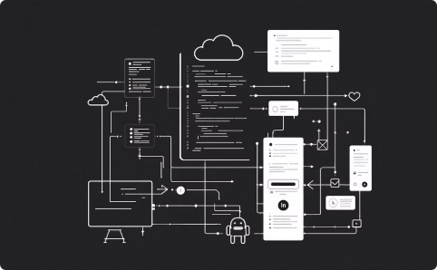

Impact, Feasibility & Why We Win
Impact & Value
Feasibility & Scalability
Why We Win
Improves student productivity and focus
Measurably reduces burnout risk
Enhances academic performance
Scalable to entire university campuses
Lightweight AI logic — no heavy infrastructure needed
Simple, proven tech stack for rapid deployment
Designed to scale campus-wide from day one
Future-ready for wearable device integration
Student-centric — built for real academic life
AI-driven — intelligent, not just informational
Predictive, not reactive — ahead of the problem
Practical and scalable — ready for the real world

Slide 10


SDG 3 — Good Health and Well‑Being
SleepWise AI is our strongest alignment with SDG 3: it improves sleep health, detects burnout early, reduces stress‑related risk, promotes mental well‑being, and encourages healthy behavioral habits. The platform focuses on preventive healthcare, mental health awareness, and lifestyle disease prevention through continuous, privacy‑first monitoring and personalized recommendations.
Prevention
Mental Health
Healthy Habits
Early detection of burnout and stress patterns to intervene before crises.
Data-driven support that strengthens resilience and reduces risk.
Personalized sleep hygiene guidance to sustain long‑term wellbeing.
“SleepWise AI contributes to SDG 3 by enabling preventive, data‑driven student mental health support.”

Slide 11
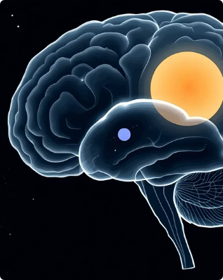
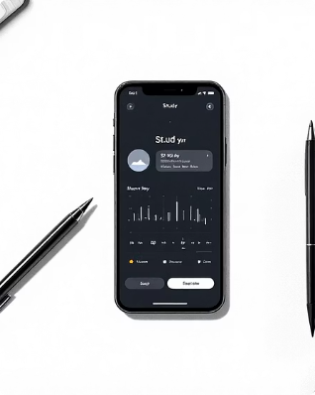

SDG 4 — Quality Education
Sleep is foundational to learning: it affects cognitive performance, memory retention, academic productivity, and burnout rates. SleepWise AI optimizes sleep to support students’ attention, consolidation of learning, and sustained academic effort — a clear path from restorative sleep to better grades and greater resilience.
Cognitive Performance
Memory Retention
Academic Productivity
Optimized sleep cycles enhance consolidation of new information for long‑term recall.
Improved sleep increases attention, processing speed, and complex problem solving.
Reduced burnout and better sleep translate to sustained study habits and classroom engagement.
“By optimizing sleep, SleepWise AI enhances learning efficiency and academic resilience.”

Slide 12
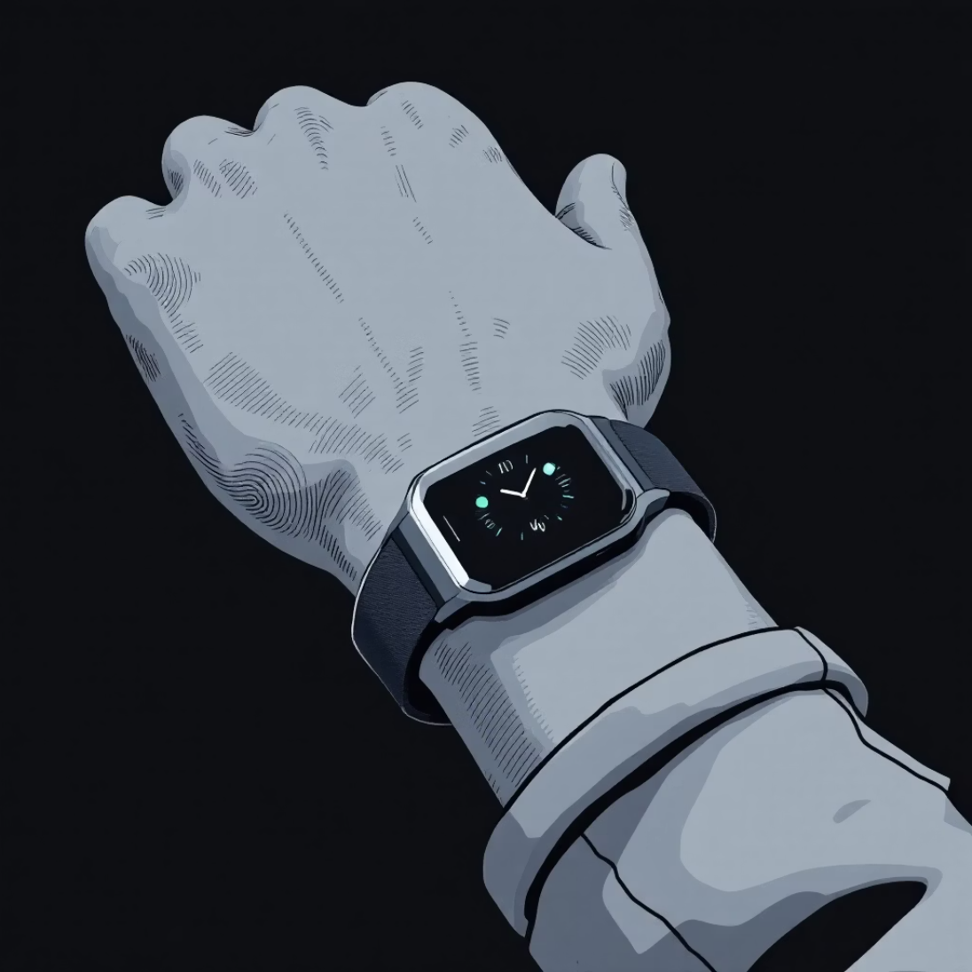
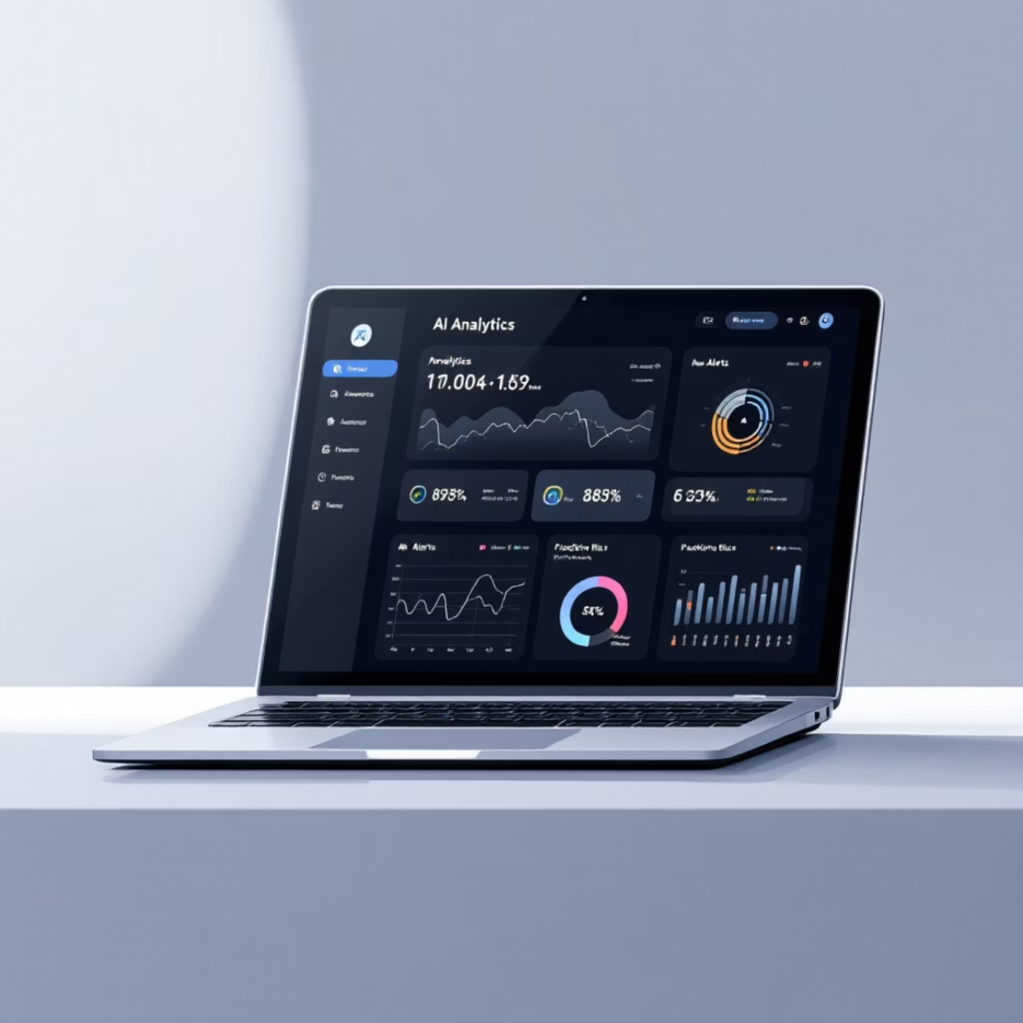


SDG 9 — Industry, Innovation & Infrastructure
SleepWise AI drives innovation by integrating wearable technology, deploying AI‑driven predictive analytics, and designing scalable digital health infrastructure. These components build robust, interoperable systems that can be adopted across educational ecosystems, advancing health‑tech innovation and resilient infrastructure for student wellbeing.
Wearables & Data
AI & Scalability
Continuous, unobtrusive sensing from wearable devices feeds secure models for personalized insights.
Predictive analytics identify risk trajectories at scale; modular architecture allows integration with campus health systems.
Interoperable Systems
Privacy & Compliance
Secure APIs and standards enable campuswide adoption and longitudinal research.
Built‑in privacy protections and compliance with student data regulations.
“SleepWise AI represents next‑generation AI‑driven health infrastructure for educational ecosystems.”

Slide 13

Thank You
"SleepWise doesn't just track sleep. It protects student potential."
Student-Centric
AI-Driven
Designed from the ground up for academic life
Predictive intelligence, not passive tracking
Real Impact
Reducing burnout, improving performance at scale
Q&A — We welcome your questions. Let's discuss innovation, feasibility, and the future of student wellbeing with SleepWise.
SLEEPWISE · AI SLEEP INTELLIGENCE · INTELLIHACK 1.0

